Slide 1


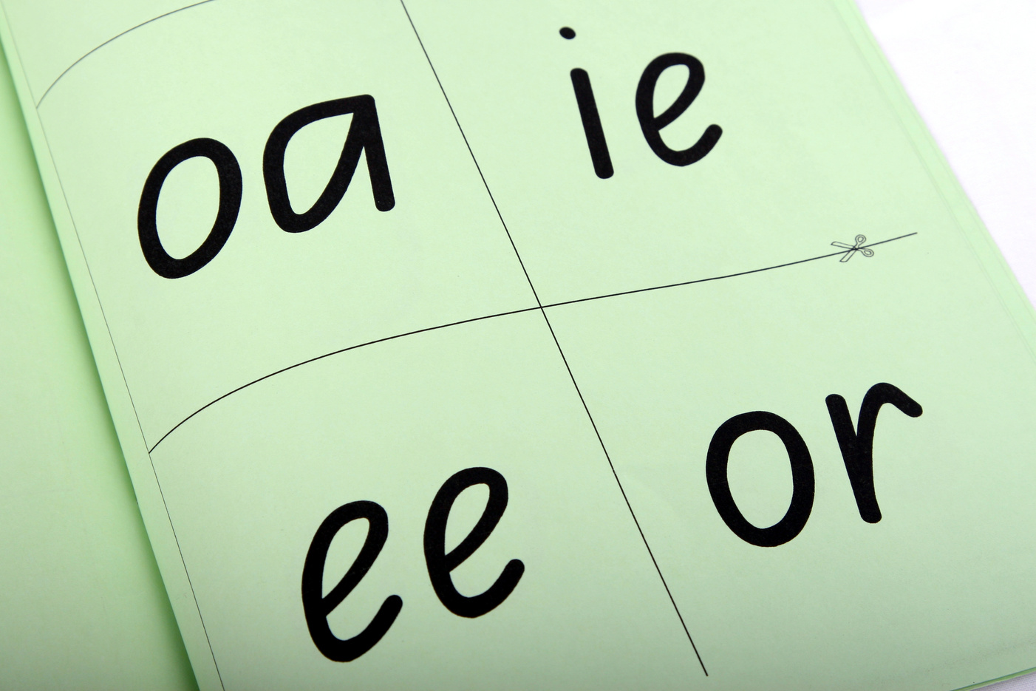

Welcome to
Year R
Phonics
Meeting for Parents
To try is to achieve, to achieve is to grow
Autumn 2026
Notes:
HC to introduce EY team

Slide 2

Phonics at Fleet Infants
As many of you will know, Fleet Infants and adopted the Little Wandle programme for phonics and reading from this year. This is a DfE validated programme with a structured progression, proven to raise reading outcomes for children. It’s currently used by over 5,500 schools in the UK.
Phoneme
Blend
Grapheme
Segment
Digraph
Adjacent consonant
Trigraph
Split digraph
Notes:
Heather

Slide 3
Foundations for Phonics
Listening and attention skills.
Differentiating between sounds.
Sharing a variety of books with children.
.
Increasing the number of words they know – their vocabulary.
Teaching a wide range of nursery rhymes and songs.
Started in pre-schools.
Notes:
Kelly

Slide 4
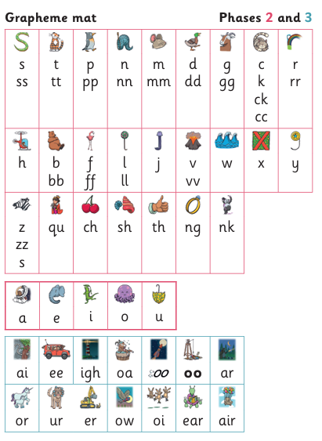
Notes:
Kelly

Slide 5
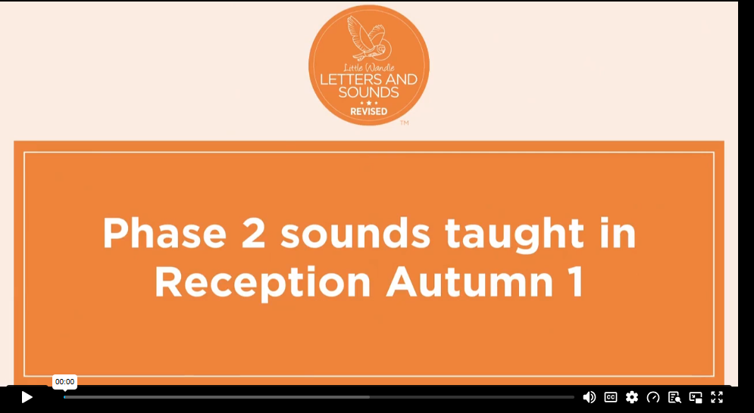
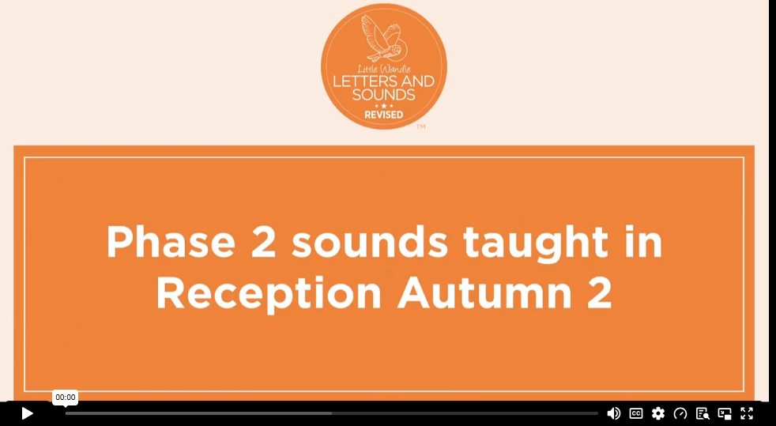
Notes:
Heather

Slide 6



Phonics in Year R
Notes:
Kelly – typical lesson structure

Slide 7

Notes:
Heather

Slide 8
Teaching Reading
Range of texts
(story, instruction, non-fiction, poetry etc)
Reading practice sessions are:
timetabled three times a week
taught by a trained teacher/teaching assistant
taught in small groups.
Story Time and an environment encouraging a love of reading
Decoding
Prosody
Comprehension
Notes:
Kelly
The children apply their phonic knowledge to reading a decodable book.
Books are carefully matched to children’s secure phonic knowledge.
They read the same book three times a week
The first time we work on decoding (sounding out) the words.
The second time we work on prosody which is reading with expression – making the book sound more interesting with our ‘storyteller voice’ or our ‘David Attenborough’ voice.
The third time we look at comprehension – understanding the text.
We read the books three times at school because we want to develop the fluency. The more children see words, the more they begin to read them automatically without having to sound them out, which is the ultimate goal.
Children’s book will then be sent home, so that they can practise their fluency further.

Slide 9

Book Matching
We use assessment to match your child the right level of book
Notes:
Heather
We assess your child every six weeks to check progress (more in the first half term).
Any child who needs extra support has Daily Keep-up sessions planned for them.
You will have noticed that your child’s books become more challenging as they secure more phonics.

Slide 10

Book Matching
This means that your child should:
know all the sounds and tricky words in their phonics book well
read many of the words by silent blending (in their head) – their reading will be automatic
only need to stop and sound out about 5% of the words by the time they bring the book home – but they should be able to do this on their own.
Notes:
Heather
Once your child is reading a Phase 3 book, we encourage them to ‘blend in their heads’ – you will remember that this is one of the strategies we use to help develop children to become fluent readers. (Blending in your head means children say the sounds quietly in their heads and then read the whole word out loud. Eventually, this will become automatic and children can read words that they know fluently.)
We will always communicate with you if we feel that your child is not blending accurately enough yet and needs additional support.

Slide 11


Home Reading
Notes:
Kelly
As well as the ‘learning to read’ book that your child will bring home they will also bring home a book for sharing with you.
This book is SO important. This is how we are going to give them the WILL to read.
Please read with your child as often as you can – at least once a day if possible.

Slide 12
Home Reading
Your child should be able to read their book without your help.
If they can’t read a word, read it to them.
Talk about the book and celebrate their success.
Notes:
Kelly
As already mentioned, your child will bring home their phonics book, matched to their reading ability, which they will have already read in school.
The purpose of this book is to practise their fluency.
Children shouldn’t find reading their phonics book hard! We want them to bring a book home that they can read mostly fluently.
If your child is finding a word hard to read, encourage them to sound and blend.
Communication with us is key. Where necessary, we will always inform you of their progress and please let us know if you have any queries.

Slide 13

Home Reading
The library book is for YOU to read:
Make the story sound as exciting as you can by changing your voice.
Talk with your child as much as you can:
  Introduce new and exciting language.
  Encourage your child to use new vocabulary.
  Make up sentences together.
  Find different words to use.
  Describe things you see.
Notes:
Reading to your child daily can open a variety of doors to your child's education, imagination and well-being.
Read the slide.
As a school, we also prioritise reading to the children daily to encourage the love of reading.

Slide 14
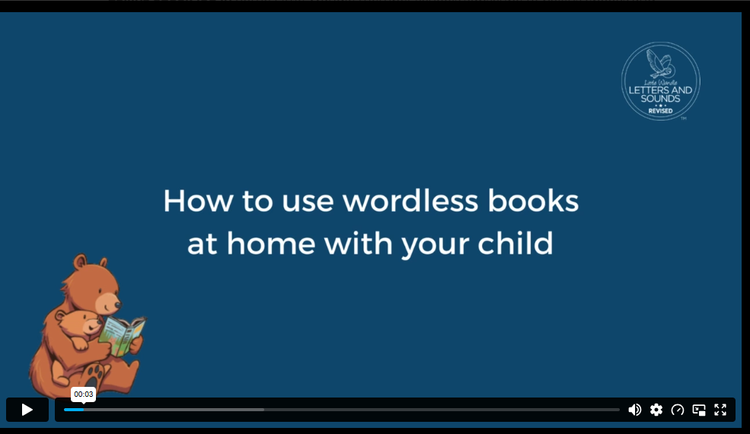
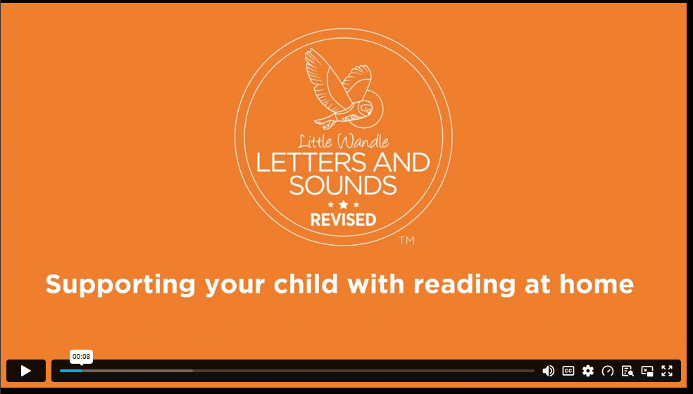
Home Reading
  What is happening?
  Who can you see?
  Where is this?
  What do you think this story will be about?
  Why?
https://www.littlewandlelettersandsounds.org.uk/resources/for-parents/
Notes:
Heather
It is really important that you pronounce the sounds correctly at home if you are supporting your child.
These videos are on the website for you to refer to and if you are unsure, please ask your child’s teacher.
Show the parents where to access the videos on the website and play them. https://www.littlewandlelettersandsounds.org.uk/resources/for-parents/
Tell the parents that ‘Little Wandle at Home’ phonics flashcards are available from HarperCollins: https://collins.co.uk/pages/little-wandle-at-home

Slide 15
Reading diaries
Completing the reading diary
  Book title, date and initials so we know to change the book
  Comments about how your child has done
  Able to decode, confident, needed help to…, could answer questions, made a prediction etc
  Use the boxes at the bottom to show sounds/words your child is unsure of
  It doesn’t need to be a word by word conversation between yourself and the child
Your comments help to inform us of the progress your child is making and what else we may need to do to support them. It also helps us to know which books have been read.
Notes:
Kelly

Slide 16
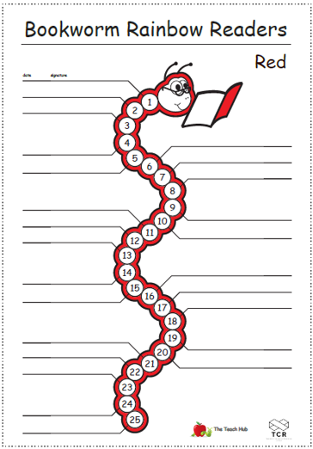
Reading a Rainbow
Each child will start again with a red sheet and when they read each day to an adult at home, the book worm is dated, signed and coloured in.
Once a worm is complete (25 days), the child receives a sticker of that colour to wear at school and they move on to the next colour of the rainbow.
There are 10 different colours that your child can complete.
Parents, you will need to sign and date the book worms at home (you will still need to sign the reading diary as well!)
Notes:
Kelly

Slide 17

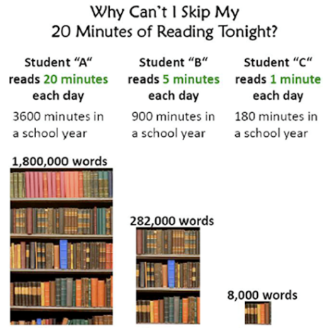
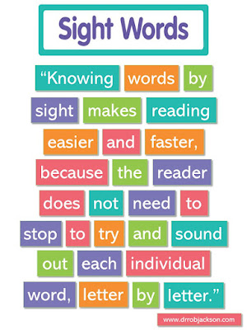
Notes:
Heather

Slide 18
“One of the greatest gifts adults can give is to read to children”
Carl Sagan
One of the greatest gifts adults can give is to read to children
Carl Sagan
Notes:
lide purpose:
Key takeaway/final message
Suggested script:
Read the quote.
Working together will ensure that your children become skilled readers.

Slide 19

5
Thank you for coming
After a lovely start to the school year, we are excited for what will be a wonderful year with your fabulous children!
Notes:
Heather

Slide 20



5
School is a partnership with you
Open door policy
Please catch us at the end of the day, call or email the main School Office if you have any questions or worries
01252 613582
info@fleet.hants.sch.uk
Thank you for your continued support
Notes:
Heather

