Slide 1
How to help your child with spelling and writing a good sentence

Slide 2
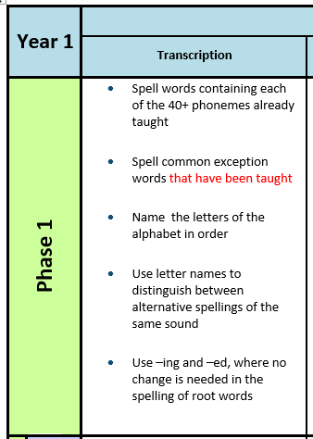
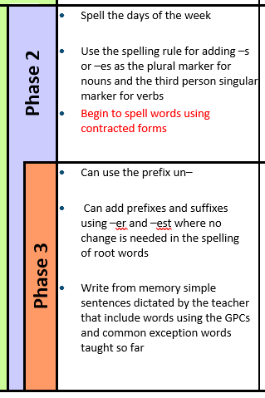

Slide 3
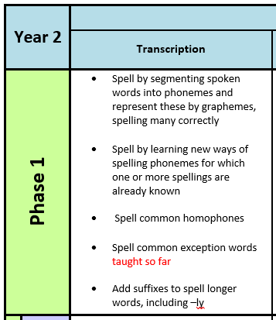
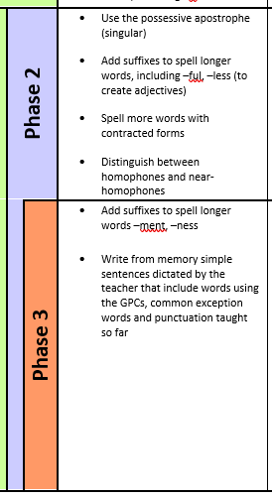

Slide 4
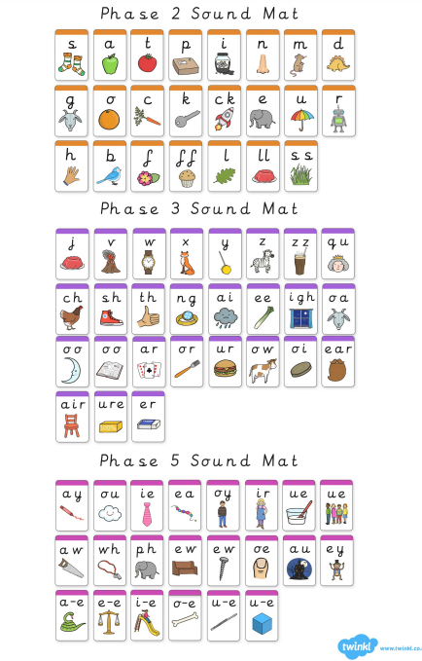
This is on the website

Slide 5
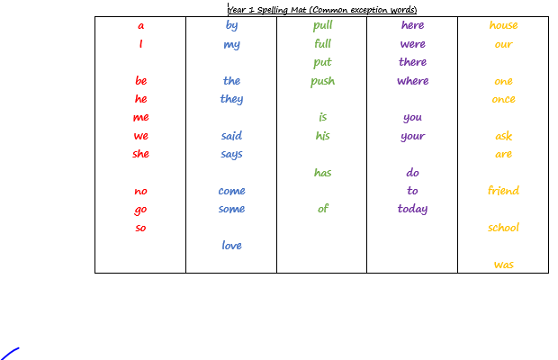
These are on the website

Slide 6
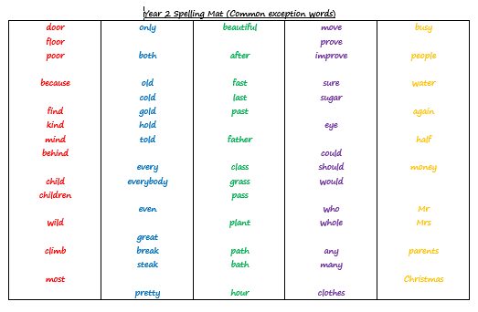
These are on the website

Slide 7
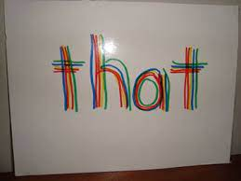
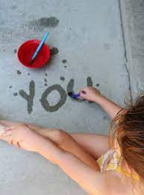
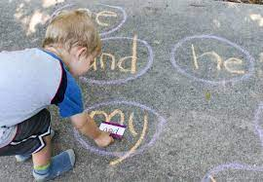
Ways to practice common exception words
Rainbow writing
Chalks
Paint brush and water
Spelling Challenge Activity (see handout)
Say the letter names as you write ‘s’ ‘a’ ‘i’ ‘d’
Mnemonics ‘save animals in danger’

Slide 8
Year 1
On the newsletter to practice each week
We practice daily and weekly in school as part of our daily phonics lessons
We use word mats and words on display in our classroom to help us when we forget.
Need to know Year R words off by heart and begin to learn the Year 1 words.
Tested termly
Year 2
In the spelling book – look, cover write, check or alternative way – see handout
We practice daily and weekly in school as part of our daily phonics lessons
We use word mats and words on display in our classroom to help us when we forget.
Need to know Year 1 words off by heart and begin to learn the Year 2 words.
Tested weekly

Slide 9
How to write a good sentence
Year 1
Capital letters to begin the sentence
Full stop at the end of the sentence
Key words spelt correctly (purple rethink)
Phonetically plausible attempts at new words e.g. huej, groosum
Adjectives (words of the day)
Use ‘and’ and ‘because’

Slide 10
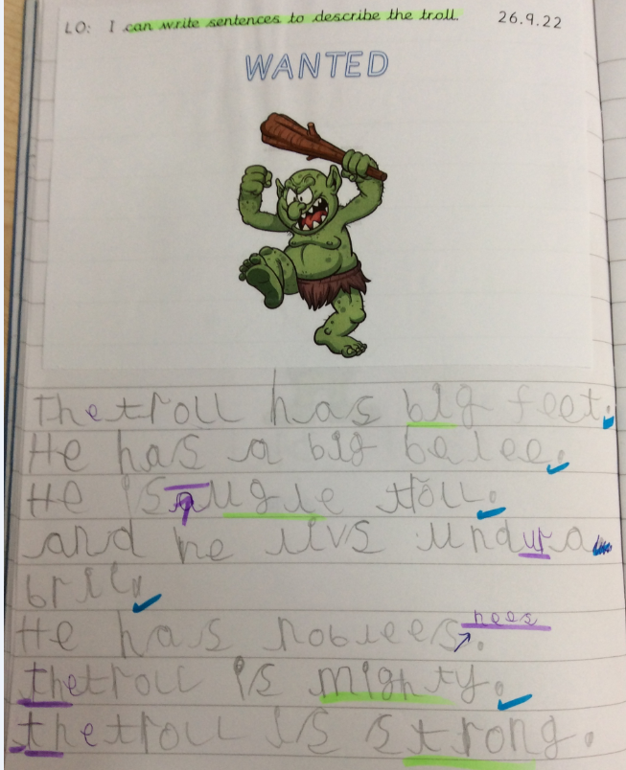
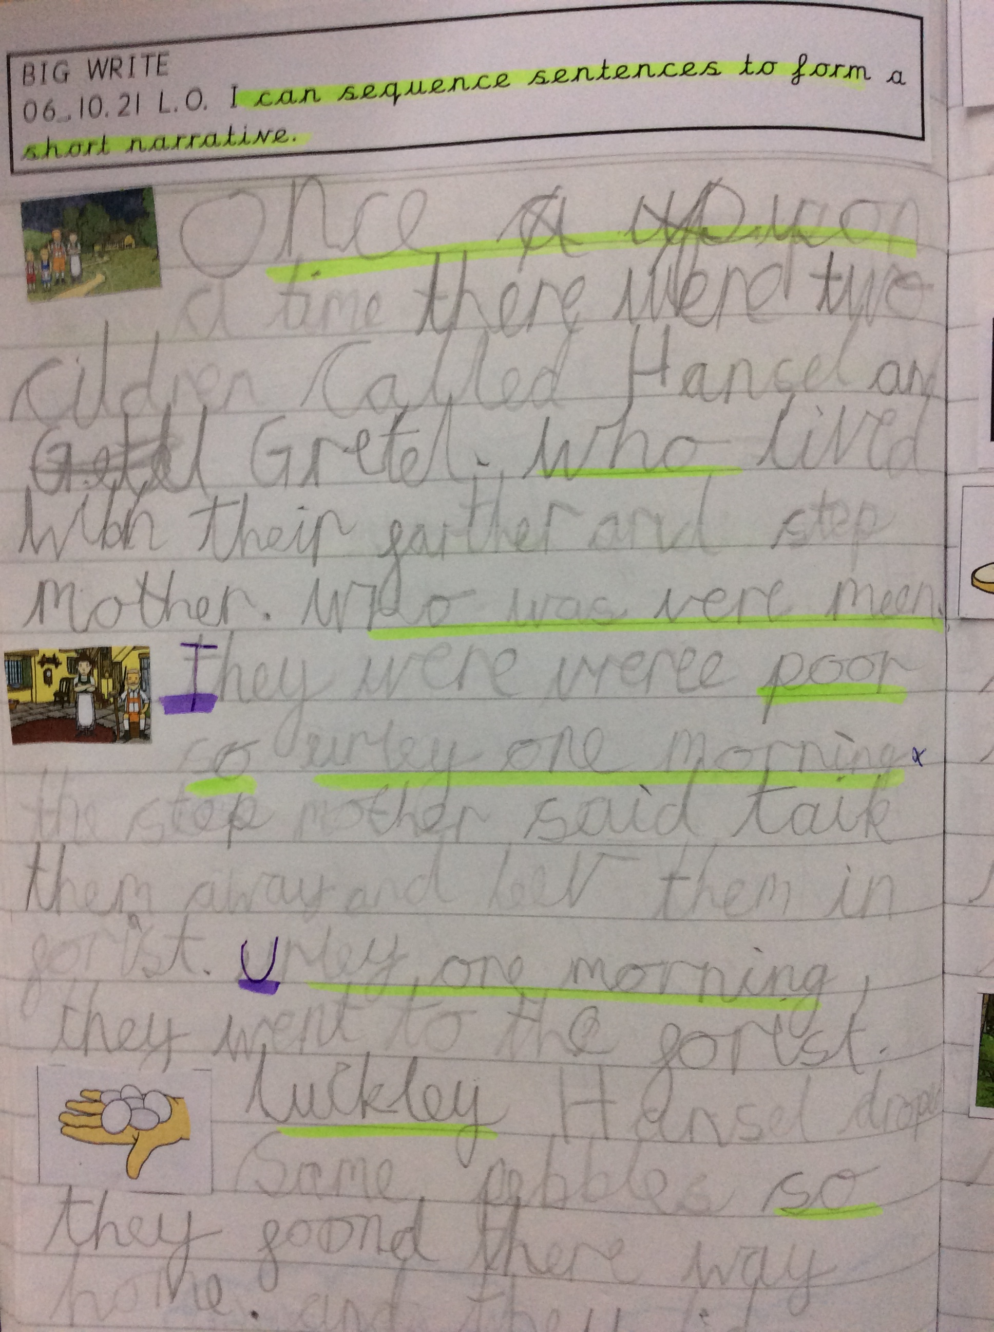

Slide 11
How to write a good sentence
Year 2
Capital letters to begin the sentence and for proper nouns
Full stop, question mark or exclamation mark at the end of the sentence
Commas in a list
Key words spelt correctly
Applying phonics and spelling rules more accurately e.g. huge, happily
Adjectives and adverbs (words of the day)
Use a range of conjunctions (and, because, when, that, so)

Slide 12
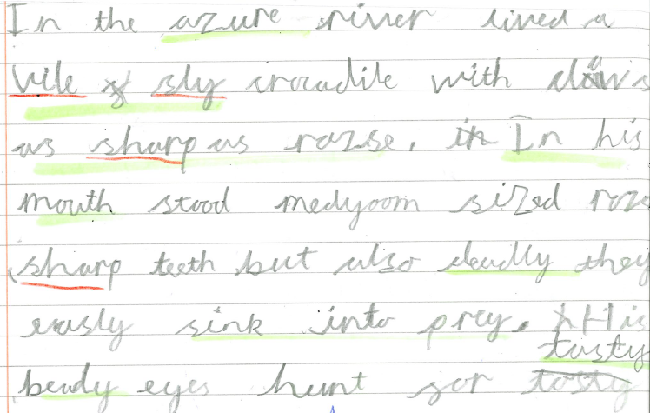

Slide 13
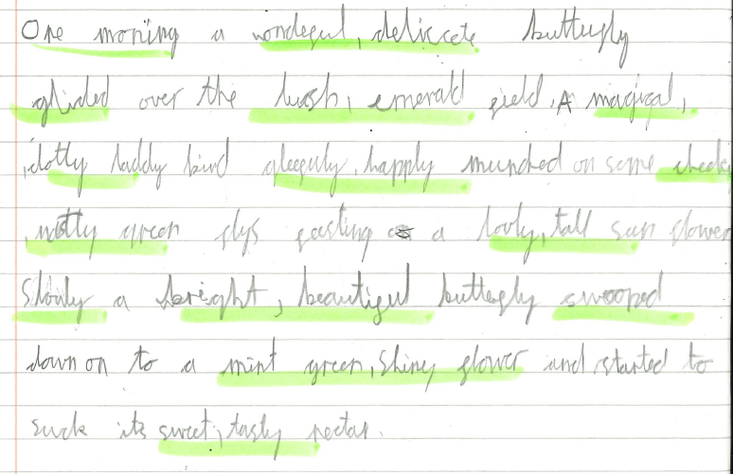

Slide 14
Please practice spellings little and often.
These key words and skills need to be learnt through the whole year so practicing at home is essential.

Slide 15
Home Learning
In both year groups, there will be opportunities to practice writing. Please use the phonic sound mats and key word cards mentioned earlier (on the website) to support.
Newsletter - spellings

