Slide 1

Fleet Infant School
Reading
November 2023

Slide 2
Domains (AREAS)
Reading has domains and each domain has statements for the children to achieve at each phase of their learning. There are 8 domains for reading at KS1.
Each phase within the reading curriculum builds on the skills from the previous phases.
Children become more confident at reading by word decoding through phonics, sight word knowledge and most importantly by reading often.
Children learn comprehension skills by reading to an adult and being taught how to interpret information in the texts.

Slide 3
Reading domains (8)
Reading – 1. comprehension- clarify
2. comprehension- monitor and summarise
3. comprehension- select and retrieve
4. comprehension - respond and explain
5. themes and conventions
6. inference
7. language for effect
8. word reading (this includes application of phonics,
and recognising high frequency words)

Slide 4








Reading domains: Skills outline from the Hampshire Assessment Model
Making meaning is the guide and the goal
Higher cognitive demand, but it is possible to train these thinking muscles at all ages
Word reading | Comprehension |  |  |  | Inference | Language for effect | Themes and conventions
Cracking the code. | Clarify | Summarise | Select and retrieve | Respond and explain | Fill gaps, make links and dig deeper. | Explore writer’s choices and impact on the reader. | Identify underlying messages and common features.
 | Stop… and notice the bits that do not make sense. | Develop a mental map of the text. | Seek the specific. | Justify an idea or opinion.

Slide 5
Reading 1:1 – How can you help your child?
Read little and often – a time when they are not tired.
Don’t tell them the word – encourage them to use their skills to decode.
Ask questions - Comprehension – Who? What? When? Where? Why? How?
As they work through the schemes, books get longer and will take them longer to read. This may mean that you read a book over a few days.
Work through the schemes at a steady pace – the children are not expected to be a free reader until they are in junior school.
Remind your child to change their books.
Share non scheme books with them and read in front of them. Apply reading to everyday life.

Slide 6
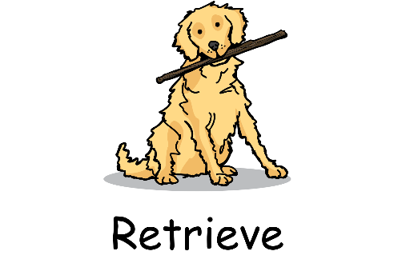
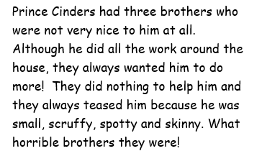
Reading 1:1 - Comprehension
Retrieval questions – the answer can be found directly in the text or pictures. Children are not guessing but being a reading detective. E.g. How many brothers did Prince Cinders have?

Slide 7
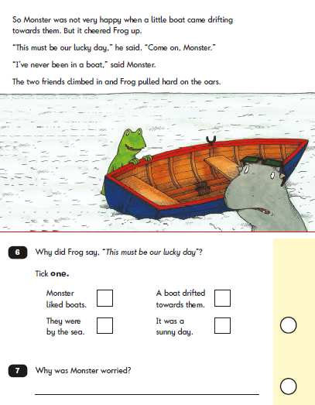

Reading 1:1 - Comprehension
Inference questions – finding the answer from clues in the text or pictures.

Slide 8
Language for Effect
Discussing the author’s word choices
In Year 1:
This means to recognise and join in with familiar, repetitive or predictable phrases
For example:
Fairy tales
Julia Donaldson books (The Gruffalo, Monkey Puzzle)
Poetry

Slide 9
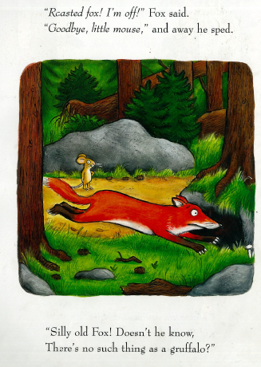
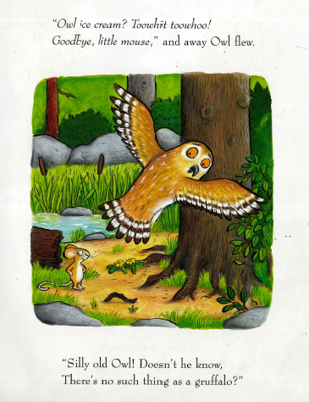
Language for Effect

Slide 10
Language for Effect
Discussing the author’s word choices
In Year 2:
Children need to recognise simple recurring literary language in stories and poetry
For example:
Story language (starters and ending, repetitive phrases)
Poetry – repeated verses and phrases
They also need to be able to discuss their favourite words and phrases
For example:
How the word / phrase makes you think differently about character, place (paints a picture in your mind) Why did you like that word? What image has it created? How does it make you feel about the character? He was sad. He was devastated.
Identify how vocabulary choice affects meaning.
For example:
Why is ________ a better word choice than ________? E.g. sad / devastated, happy / ecstatic

Slide 11
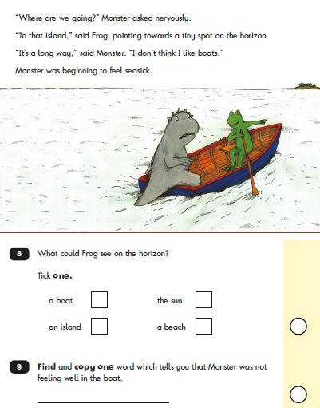
Language for Effect

Slide 12
Clarify – Comprehension -QUESTIONS-
What do you think that word means?
Can you explain what that sentence means?
Monitor and Summarise - Comprehension
Can you tell me about what happened?
What happened next?
Where did they go after …?
How did the story end?
Select and Retrieve - Comprehension
Who are the main characters or what are the main events in the story?
Extracting facts from information texts.
Respond and Explain - Comprehension
Prompt children to start thinking about cause and effect in the story – e.g. character motivation
Why do you think … has done that?
Prompt children to start thinking about layout
features, e.g. Why is the text bold? Why is the text enlarged?

Slide 13
Inference
How do you think … will feel?
What do you think … will do?
Why do you think … feels …?
Prompt children to think about how a character is feeling or what they might be thinking.
Language for Effect
Can you find the words that rhyme?
Can you find the word that rhymes with …?
Themes and Conventions
Why do you think the title of this book is …?
How do you know it is a fairy tale?
Do you think … is a good character?
Compare one book to another:
What is the same about … and …?
How is the ending different to …?
Does this book remind you of any others you have read? Why?

Slide 14
Reading
.
https://www.gov.uk/government/publications/ks1-english-reading-exemplification-working-at-the-expected-standardyoutube.com/watch?v=w4c_DMS-3IE

