Slide 1
Fleet Infant School
Maths Curriculum

Slide 2
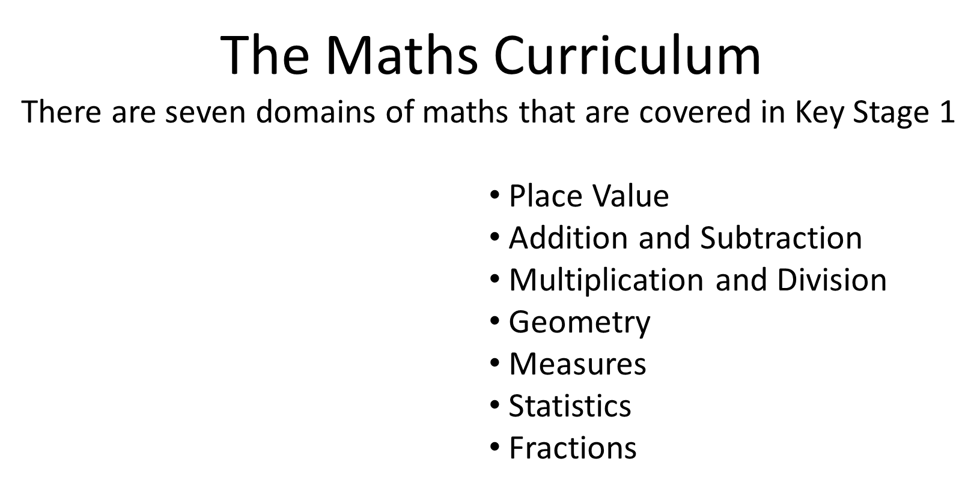

Slide 3
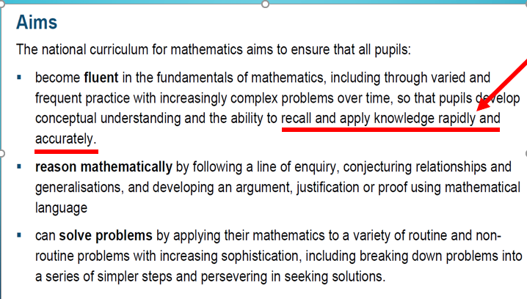

Slide 4
There are lots of mental skills and strategies that we need to master in order to become quicker and more accurate at number work and calculation. These skills will help your child with maths in everyday life.
For example :
when they need to work out how much to pay for a few things when shopping
how much change they should get
how to work out how far a journey is or how long it will take.
It’s fine to use fingers – and other resources – to help their thinking when they are learning in maths. But there are some things that it is really useful to just know – and to be able to recall instantly. The more of these facts they have in their “toolkit”, the easier and quicker it will be to solve a mathematical problem or work out an answer or solution.

Slide 5
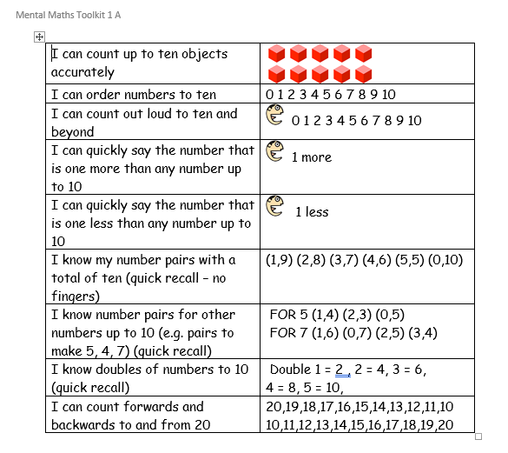

Slide 6
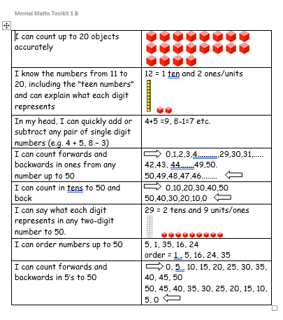

Slide 7
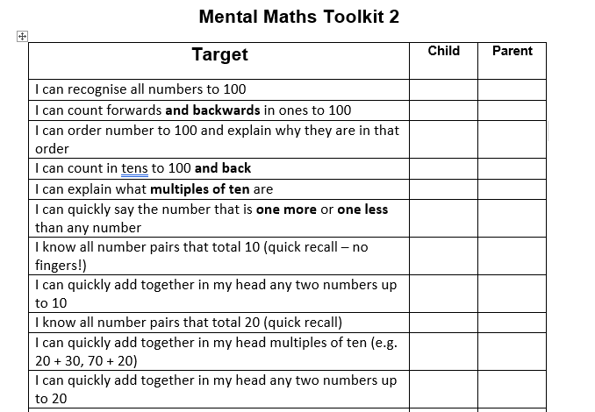

Slide 8
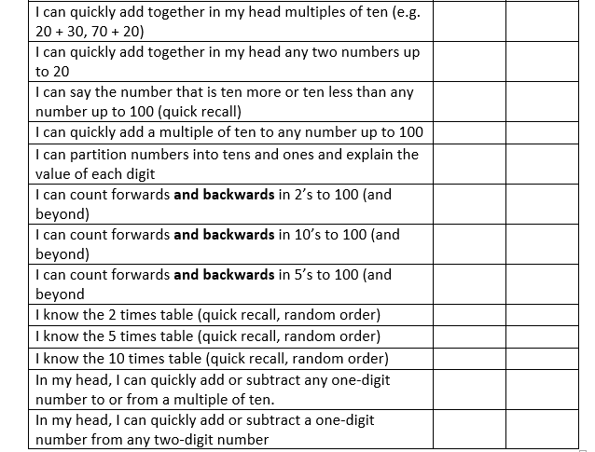

Slide 9
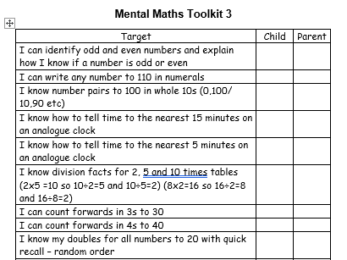

Slide 10
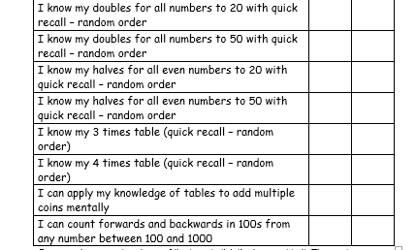

Slide 11
Games you can play at home to support Maths:
Paint the Squares - Interactive Number Charts (topmarks.co.uk)
Daily 10 - Mental Maths Challenge – Topmarks
Number bonds, addition, subtraction – start at level 1
Shark Numbers || To know what each digit in a 3-digit number represents - mobile friendly (ictgames.com)
There are lots of games on topmarks and ictgames to support all areas of the Maths curriculum – please feel free to explore.

Slide 12
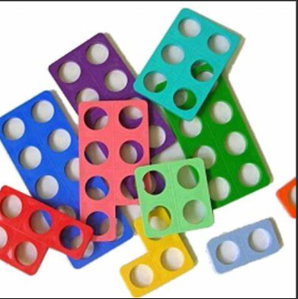
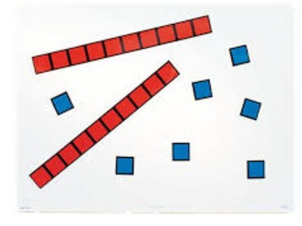
Supporting Addition:
Introduce vocabulary related to addition: add, plus, more than,
make, and, sum of, altogether, total
Step 1 – use concrete equipment (diennes, numicon, pasta, lego)

Slide 13
Step 2 –
Drawing diennes
24 + 12 =

Slide 14
Partitioning
24 + 12 =
24 + 10 = 34
34 + 2 = 36

Slide 15
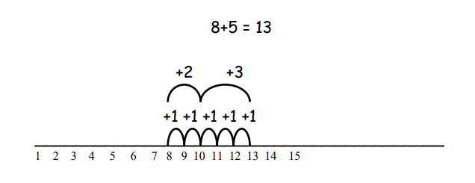
Step 3
Structured Number line

Slide 16
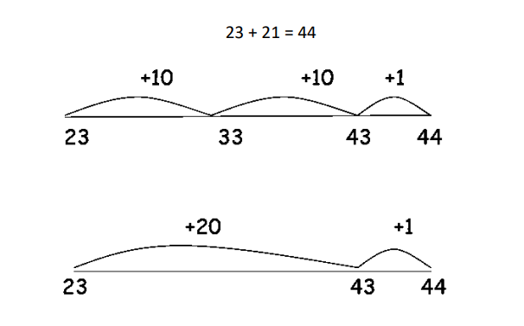
Unstructured Number line

Slide 17
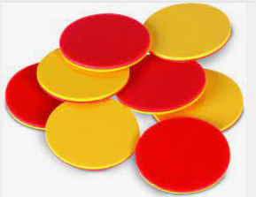
Supporting Subtraction:
Introduce vocabulary related to subtraction: minus, less than,
take away, subtract, difference between, count back
Step 1 – use concrete equipment (diennes, place value counters, pasta, lego)

Slide 18
Step 2 –
Drawing diennes
24 - 12 =

Slide 19
Partitioning
24 - 12 =
24 - 10 = 14
14 - 2 = 12

Slide 20
Step 3
Structured Number line
18 – 4 = 14

Slide 21
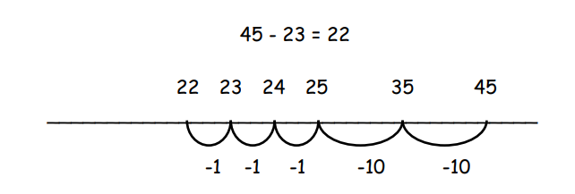
Unstructured Number line

Slide 22
Weekly newsletter will say what we are learning this week and next. It will also give you ideas for how you can help at home.
Fleet Infant School Calculation Policy
How to support your child in maths
on the website :
Maths | Fleet Infant School

Slide 23
Any questions ?

