Slide 1


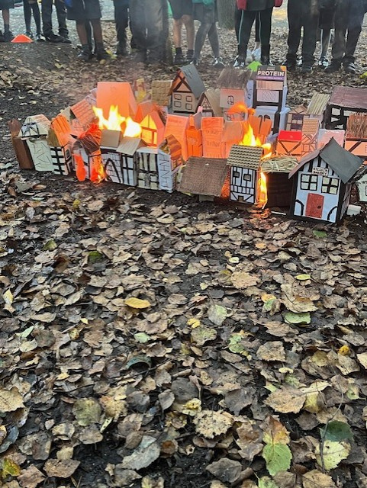

Welcome to
Year 2
Curriculum
Meeting for Parents
To try is to achieve, to achieve is to grow
Autumn 2025

Slide 2
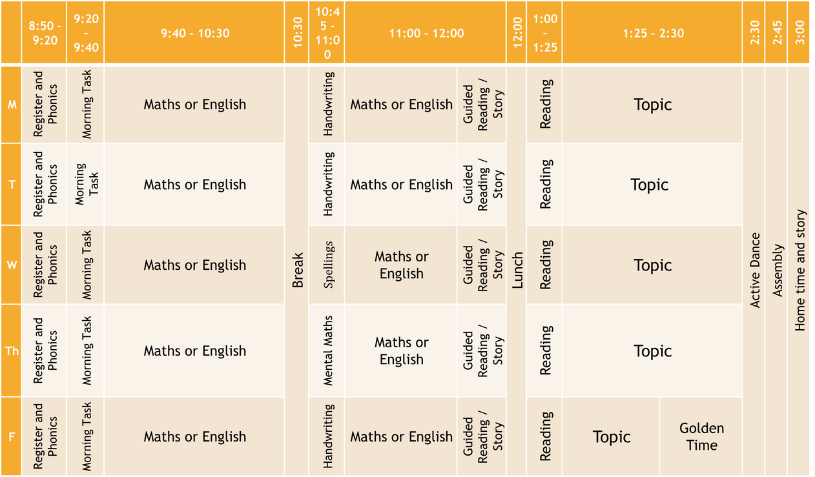
A typical Year 2 day

Slide 3
Learning at home in Year 2
Reading
Maths Challenge
  The more children read, the more fluent they will become.
  Try to read 3-5 times a week.
  Ask questions around the text to help their comprehension skills – who, what, why, when.
  Discussion of language – do children understand what new words mean? Ask children to make predictions about what will happen.
  Reading a Rainbow - sign for each day a child reads.
  Twice every half term – to be completed with support. It is a challenge not an independent piece. Allow children to do what they are capable of.
Home Learning
  Every half term. Linked to topic work. GFOL house this half term.
Mental Maths Toolkits
  The children will have these from Year 1.
  Mental maths skills are the foundation for their maths learning.
  Support frequently – little and often.
  We will test in school and update every half term and send a copy home.
Newsletter
  What we have been and will be learning. Suggestions of how you can support them at home.

Slide 4
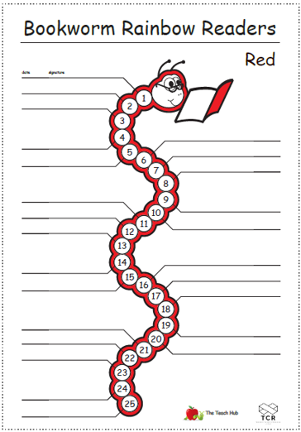
Learning at home in Year 2
Each child will start again with a red sheet and when they read each day to an adult at home, the book worm is dated, signed and coloured in.
Once a worm is complete (25 days), the child receives a sticker of that colour to wear at school and they move on to the next colour of the rainbow.
There are 10 different colours that your child can complete.
Parents, you will need to sign and date the book worms at home (you will still need to sign the reading diary as well!)

Slide 5
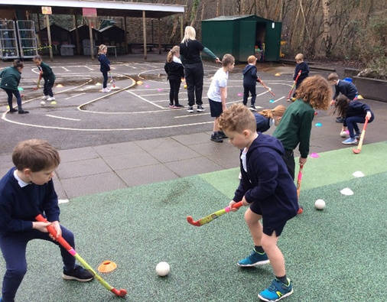
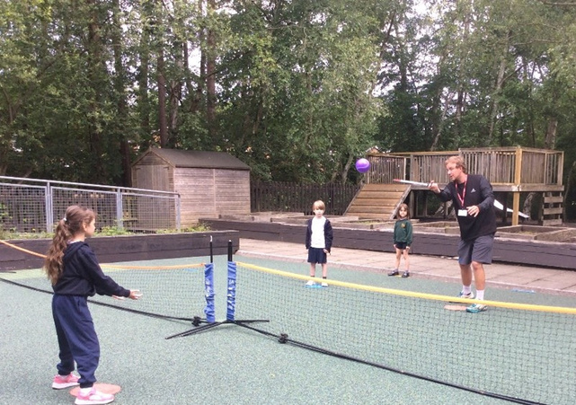
P.E. in Year 2
P.E. will be on Fridays (gymnastics this half term) and Wednesdays.
Please make sure P.E. kits are in school every day. Named (Navy shorts, trousers/leggings for the cold weather, white t-shirt and navy sweatshirt/hoodie plus plimsolls/trainers).
Hair tied back if it is long (boy/girl) and earrings taped or removed on P.E. days.
Children will also be learning hockey and tennis led by outside coaches.
After school sports clubs run through the year.

Slide 6




How we keep in contact
Child Formal Parents Evening
Twice a year (Autumn & Spring)
Written Reports
End of year (Summer)
Open Door Policy
Best time is during pick up
Notes for Going Home
If your child is going home with different adults or has an appointment

Slide 7

Our website is full of useful information
Curriculum information
What the children will be learning in each subject.
PLUS
Handouts
Class updates (work, photos, videos etc)
Letter formation sheets
Spelling sheets
PowerPoints of presentations

Slide 8
Learning behaviours & values
Rising to the Challenge
Perseverance
Managing distractions
Kindness
Gratitude
Courage
Respect
Resilience
Honesty
We have a value in focus each half term.
This half term’s value is respect.

Slide 9

Behaviour system & class treats
Continued exceptional behaviour and positive attitudes to their learning
Children are put on silver when they do something/behave in a way that goes above and beyond what is expected. They can be moved onto the star if they continue to show exceptional behaviour or positive attitudes to their learning.
Where every child will begin at the start of everyday.

Slide 10
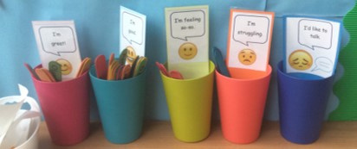
Mentally healthy school
  Your child’s health, personal, social and mental wellbeing form an integral part of our curriculum.
  We teach children how to be resilient in all aspects of their life through our Personal Development
  Lessons which look at healthy minds and bodies, rights and responsibilities, emotional wellbeing and many other aspects of being a happy and socially rounded young human being.
  PDL curriculum – relationships, staying healthy
  Lolly sticks – each morning and playtimes to check in. Adults will follow up if a child is not feeling good that day.
  What went well?
  Circle time
  Singing, sport, performance and play

Slide 11
Curriculum
The children are expected to be fluent and independent in their learning.
The national curriculum is a mastery curriculum. This means that children will learn fewer things but what they do learn they will learn in much greater depth.
  They will learn and practice a skill
  Apply the skill in a variety of ways
  Master the skills and use it in different contexts
  E.g in Maths, the children may apply their skills of addition and subtraction to solve an open-ended problem and reason
During and at the end of the year, the children in Year 2 will be assessed against this curriculum. Final teacher assessments will be reported to parents on the summer written report.

Slide 12
Foundation subjects
These are some of the topics and skills the children will learn in the foundation subjects throughout the year.
HISTORY
GEOGRAPHY
RELIGIOUS EDUCATION (R.E)
Great Fire of London, Famous Pirates, Florence Nightingale & Mary Seacole
Weather, map skills, comparative studies for two locations
Hindu and Christian faith in focus. Advent, Special places, Special foods
DESIGN AND TECHNOLOGY (D&T) AND ART
PHYSICAL EDUCATION
SCIENCE
Lifecycles, Materials, Growing Plants, Forces
Dance, Gymnastics, Games & CM sports
Collage, Illustrations, Sketching, Sculpting, Joining and fixing materials, Food preparation

Slide 13
End of year assessments
At the end of KS1, children will be assessed as having either a ‘Secure’ understanding of the curriculum or not.
  Children who are not secure will be described as ‘Working Towards’ age related expectations.
  Children who can demonstrate a deeper understanding will be described as working at ‘Greater Depth’ within the age related expectations.
The children will need to meet all the objectives within Working Towards, Expected or Greater Depth in order to be assessed at this level.

Slide 14
English, Reading & Mathematics
For English, Reading and Mathematics there will be three standards:
Working towards the expected standard
Working at the expected standard
Working at greater depth within the expected standard
For Science there is one standard:
Working at the expected standard
Each standard contains a number of ‘pupil can’ statements.
Teachers need to judge a pupil’s attainment of all statements within the standard and all statements in the preceding standard(s). These statements cover key learning within the curriculum at each standard.

Slide 15
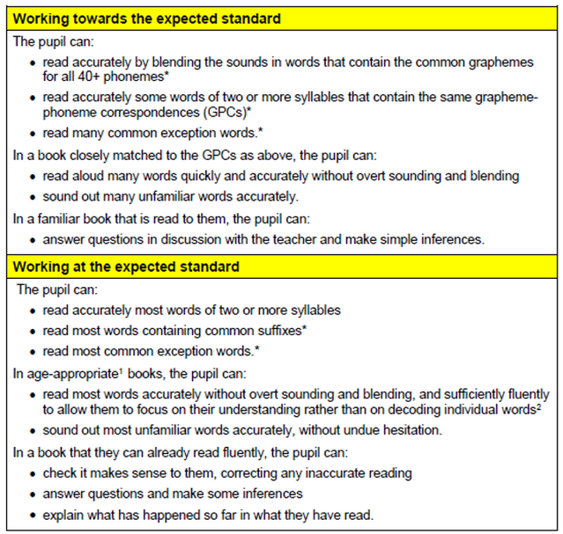

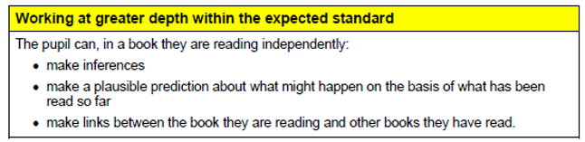
Reading

Slide 16






Reading -links to other stories

Slide 17
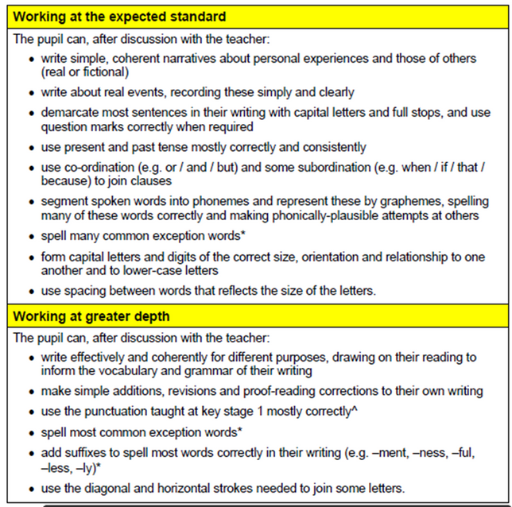
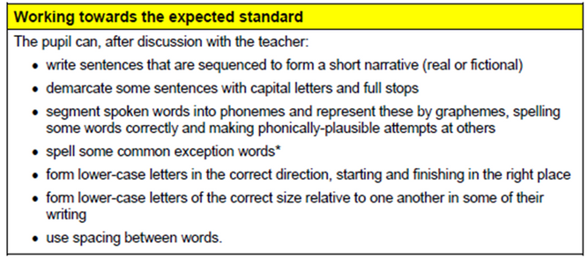

Writing

Slide 18
Writing in Year 2
Higher focus on
INDEPENDENCE
STAMINA
HANDWRITING
We assess independent pieces
Writing longer pieces maintaining high quality e.g using punctuation consistently
Correct size and orientation
SPELLING
EDITING THEIR WORK
Accurately applying taught rules (suffixes), common exception words for Year 1 and 2 must be correctly spelt
(punctuation, spelling, better word choices and words of the day, checking for sense)

Slide 19

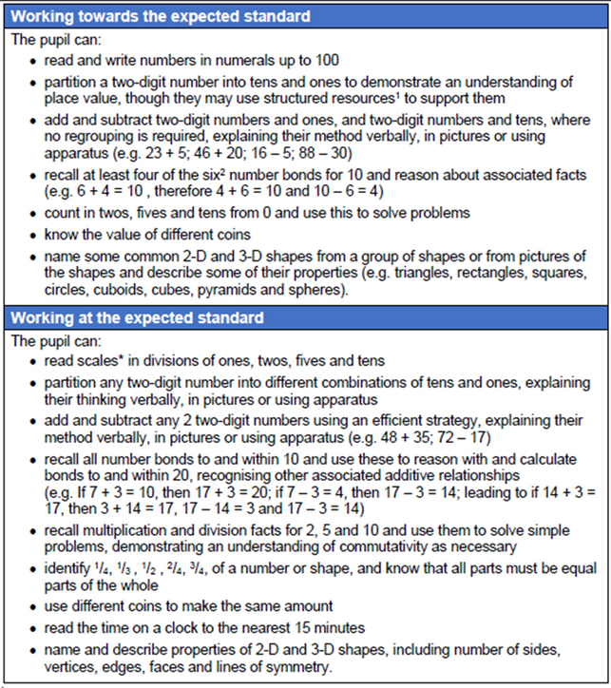
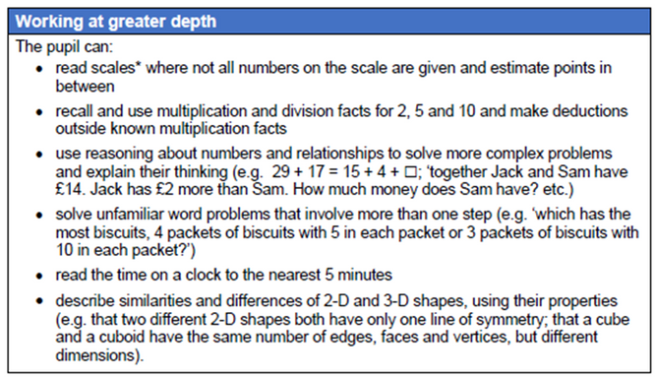
Maths

Slide 20

Maths in Year 2
Higher focus on reasoning and problem solving
QUICK MENTAL RECALL
EXPLANATION
REASONABLE ESTIMATES
Quick mental recall of number facts and times tables and applying this to problem solving
Can they explain how they worked out the answer?
Prove it!
“44 + 45 must be 89 because 40 and 40 is 80 and 4 and 5 is 9”
Making reasonable estimates at an answer.
“38 + 46 must be lower than 100 because both numbers are smaller than 50”

Slide 21

Teacher assessment
Teacher assessment is based on knowledge of how the pupil has performed over time and in a variety of contexts. It takes into account strengths and weaknesses of the pupil’s performance.

Slide 22
Moving forward
You can help your child and the School by:
Practise number bonds to and within 20
Practise times tables (2, 3, 5, 10)
Practise mental maths in the toolkits
Practise spellings and spelling rules
Reading as often as you can with your child, daily would be wonderful!
Support your child to tell the time to 5 minute intervals
Handwriting is important, encourage your child to remember presentation when they are writing

Slide 23



5
School is a partnership with you
Open door policy
Please catch us at the end of the day, call or email the main School Office if you have any questions or worries
01252 613582
info@fleet.hants.sch.uk
Thank you for your continued support

