Slide 1


Slide 2










How do we fundraise?
Christmas Events
Easter Events
Summer Events
Second Hand Uniform Sales
Tuck shop
Children’s Gift Shops
Non-Uniform Days
Sponsored Events
Discos

Slide 3




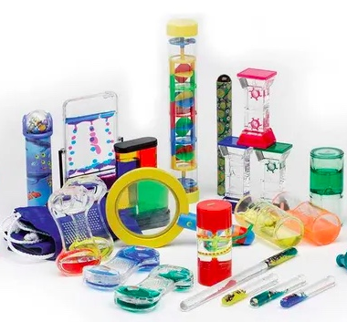




How is the money spent?
ICT Licences
PPA Cover
Reading & Library Books
Curriculum Based Resources
Forest School Equipment
Sensory Equipment
Easter Eggs
Pantomime
Christmas Crackers

Slide 4

How can YOU help?
“Don’t worry, we’ve got enough volunteers”
said no PTA ever!!!
Committee
FISA Helpers
REGULAR
AD HOC
Online Meeting – once a month
Express an interest in helping
Help with ideas / vote
Join our database of helpers
Help at Events
Social Evenings
Email sent when help is needed
Email: fisa.email@gmail.com
Email: fisa.email@gmail.com

Slide 5
Corporate Match Funding
How can your company help us?
Does your company have a Corporate Match funding scheme?
Can they support by matching any funding you raise?
Can you volunteer your time during business hours to support charity?
If the answer is YES! How can you support FISA?
FISA is a registered charity and any help either financially or physically is HUGELY appreciated!

Slide 6



fisa.email@gmail.com

